Slide 1

Project Morpheus: Supersonic Transport Jet Design
Charles Evans, Grace Krahn, Alec Liberman, Juan Jose Paez, and Eric Qiu
11 April 2022

Slide 2

Mission Overview
RFP: design a supersonic transport aircraft to carry out two possible missions
Standard mission: normal mission with supersonic cruise
Alternate mission: takeoff, subsonic cruise, supersonic cruise, subsonic cruise, descent and landing

Slide 3
Requirements
Payload: 50 passengers with baggage & 4 crew
Engines: 4 low-bypass turbofan engines
Range: 4000 nm supersonic cruise or 1000 nm subsonic cruise and 3000 nm supersonic cruise
Supersonic cruise at Mach 2 at 55000 ft
Subsonic cruise at Mach 0.95 at 35000 ft
Approach speed: 140 knots
Runway length: 8500 ft

Slide 4
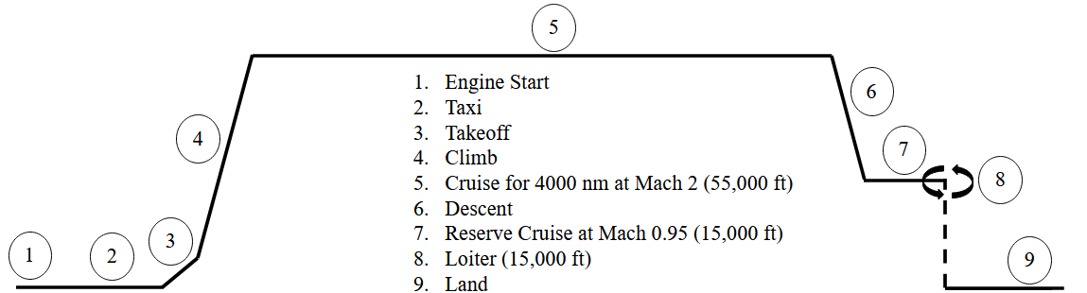
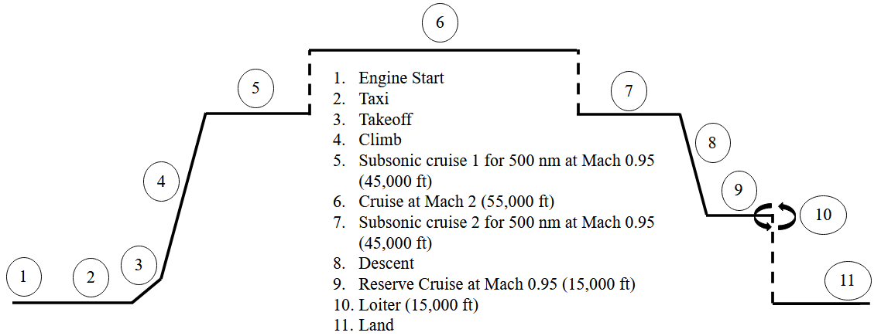
Mission Profile
Standard mission
4000 nm Mach 2 cruise
Alternate mission
3000 nm Mach 2 cruise
Two 500 nm subsonic segments
Requirement pushback on subsonic cruise altitude (< 50,000 ft)
Sizing mission

Slide 5
Market Analysis
Renewed interest in SST aircraft due to gap left by Concorde and Tu-144
Engine performance, aerodynamic understanding, other improvements lead to higher efficiency than late 20th-century design allowed
Supersonic jet market size in North America alone
2019: $8.87 bil USD
2020: $8.93 bil USD
2030: $35.62 bil USD (projected)
Virgin Group, Japan Airlines, others have garnered $6 bil worth of pre-orders for similar aircraft
Project Morpheus fills the trans-Atlantic business travel niche

Slide 6
Configuration Selection
Figure of Merit (FOM) | Relative Weight | Definition
Stability | 0.1 | Relative contributions of features to overall aircraft stability
Controls scheme | 0.1 | Optimality of control surface locations, sizes, & interconnectedness
Development cost | 0.1 | Upfront cost needed to achieve technology and design readiness
Maintainability | 0.3 | Comparative upkeep cost in the system complexity and accessibility
Manufacturing simplicity | 0.1 | Relative ease of creating and mechanically assembling the system
Supersonic performance | 0.3 | Assessment of aerodynamic qualities (drag) at supersonic cruise
Weighted Pugh matrices evaluated component configuration options using the FOM:
Wing shape: highly swept with Yehudi, ogival delta, double delta, trapezoidal with canard
Engine location: below wing, above and below wing, tail-mounted
Tail type: T-tail, conventional, split V-tail, single vertical tail
Fuselage: standard, blended wing, wide
Landing gear layout: trike, tail dragger, tandem
*Note: bolded words are the chosen configuration

Slide 7
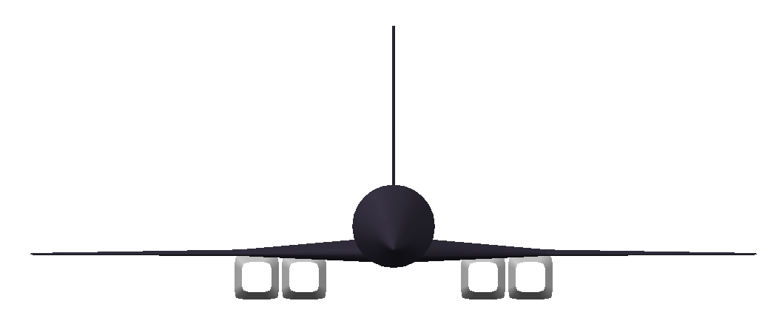
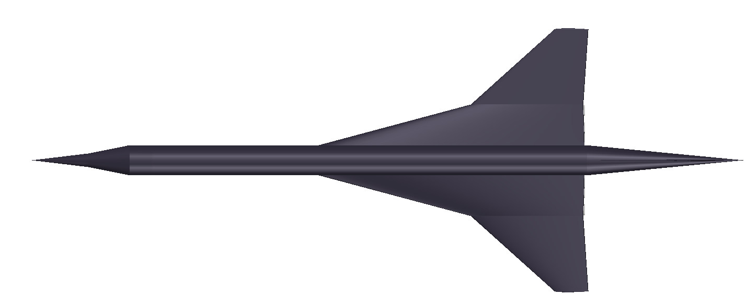
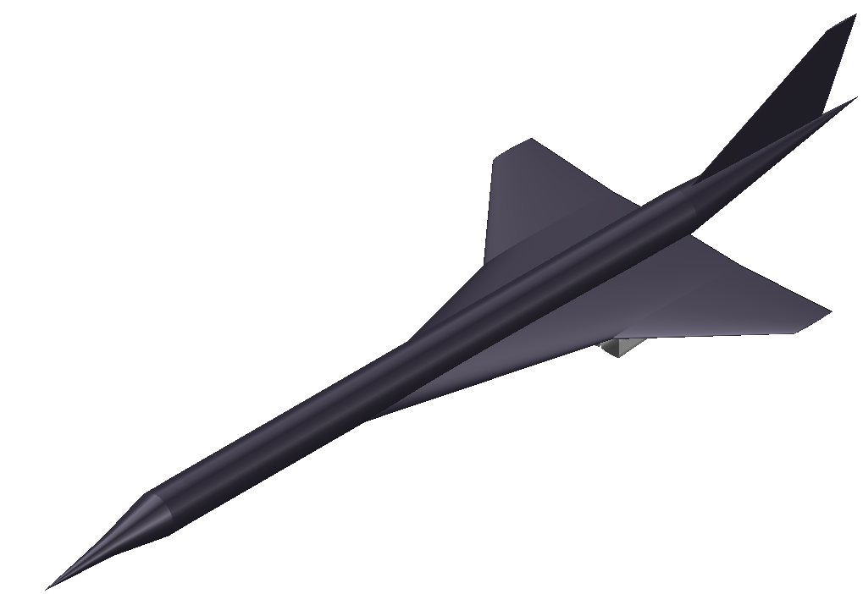
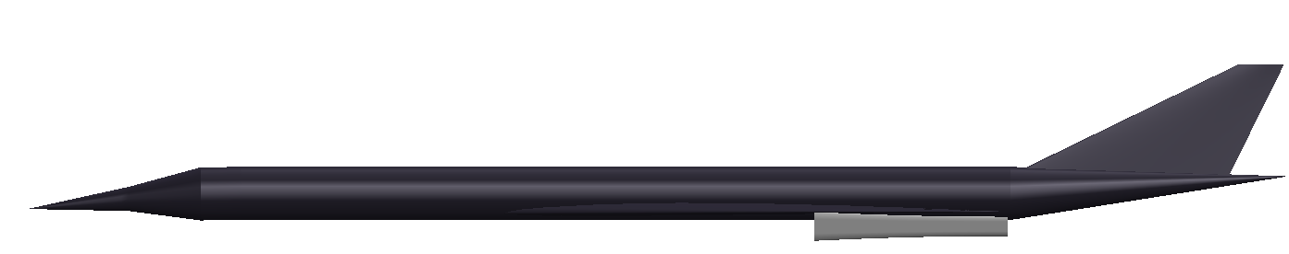
Design Overview
48 ft
6.2 ft
Passengers: 50
Engines: 4
Wing area: 1180 ft²
Aspect ratio: 1.95
21 ft
59 ft
75°
48°
130 ft
6 ft

Slide 8
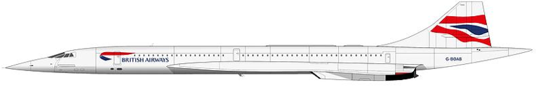
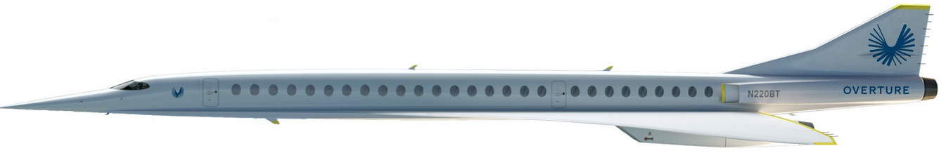
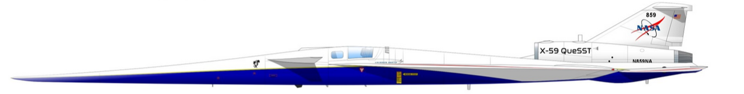
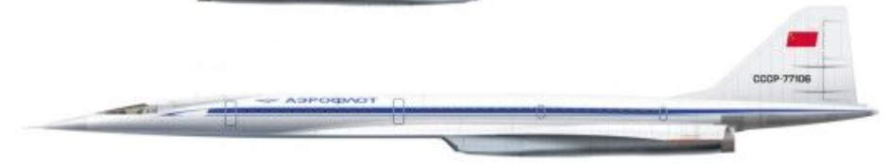
Aircraft Size Comparison
Supersonic Cruise Aircraft Lengths
Aircraft | Length
Project Morpheus | 130'
Concorde | 203'
Boom Overture | 205'
QueSST X-Plane | 94'
Tupolev Tu-144 | 216'
https://fineartamerica.com/featured/2-british-airways-concorde-1997-to-2003-steve-h-clark-photography.html
https://boomsupersonic.com/overture
https://www.kclu.org/local-news/2022-02-10/south-coast-based-aviation-historian-authors-new-book-about-history-of-groundbreaking-x-plane-series
https://www.pinterest.com/pin/344666177708740775/

Slide 9
Vehicle Weights
Project Morpheus Weights
Weight Comparison to Other Aircraft
Weight | Value (lb)
MGTOW | 129,815
Empty | 58,346
Fuel | 58,590
Payload | 11,500
Aircraft | MGTOW (lb) | Empty Weight (lb) | Max # of Passengers
Concorde | 408,000 | 173,500 | 100
Boom Overture | 265,600 | 218,700 | 88
QueSST X-Plane | 25,000 | 14,990 | 1
Tupolev Tu-144 | 456,357 | 218,699 | 135
Boeing 737 MAX 7 | 177,000 | 138,700 | 153

Slide 10
Constraint Sizing
Weights
MGTOW
Empty
Fuel
Payload
Comparison to existing aircraft weights
Project Morpheus
Aircraft | T/W (~) | W/S (psf)
Project Morpheus | 0.405 | 111.6
Concorde | 0.373 | 106.8
Tupolev Tu-144 | 0.440 | 83.7
T/W (~) | W/S (psf)
0.405 | 111.6
Concorde
T/W (~) | W/S (psf)
0.373 | 106.8

Slide 11
Component Estimated Weights and Inertia
Component | Weight Estimate
Wing | 13,560
Empennage | 1406
Nacelles | 9511
Landing Gear | 2316
Power Plant | 4631
Fixed Equipment | 11,660
Empty | 58,350
Weights and inertia estimated from Roskam V supersonic cruise aircraft
AST-110
SSXJET
Super-cruiser
NAA A3J-1
Ixx (slug-ft2) | Iyy (slug-ft2) | Izz (slug-ft2)
133,600 | 2,357,000 | 1,778,000

Slide 12
CG Excursion
Mean Aerodynamic Cord (MAC): 26.6 ft
Mean Geometric Cord (MGC): 24.6
At most aft CG,
Load on NG: 10.67%
Load on MG: 89.33%

Slide 13
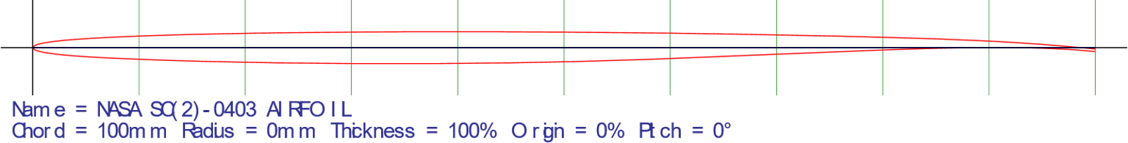
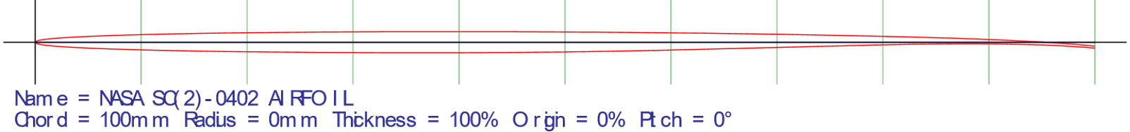
Airfoil Selection
 | Tip | Root
Max Thickness | 2% @ 34%c | 3% @ 36%c
Max Camber | 0.5% @ 85%c | 0.6% @ 85%c
Factors to consider
Mach cone characteristics
Design shape (supercritical)
Thickness effect on Cdwave (function of thickness squared)
http://airfoiltools.com/airfoil/details?airfoil=sc20403-il
http://airfoiltools.com/airfoil/details?airfoil=sc20402-il

Slide 14
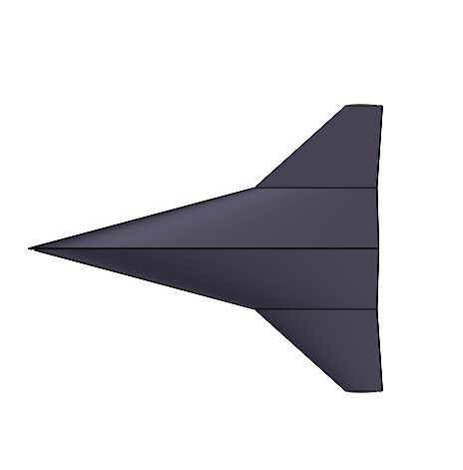

Wing Design
Compound Delta wing configuration
Aspect Ratio 1.95
Low aspect ratio requires less extensive internal structure
Vortex lift at low speeds
Large fuel storage volume while maintaining low thickness
https://www.heritageconcorde.com

Slide 15
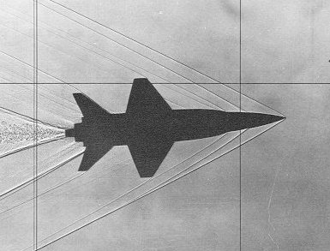
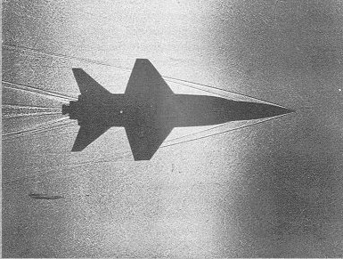
Wing Design continued
Sweep angles
Double Delta
75° and 48°
High initial sweep to avoid the Mach cone and delay wave drag onset
Secondary sweep allows for greater area for lift generation and control surfaces
X-15 Mach 3.5
X-15 Mach 6
https://history.nasa.gov/SP-60/ch-5.html

Slide 16
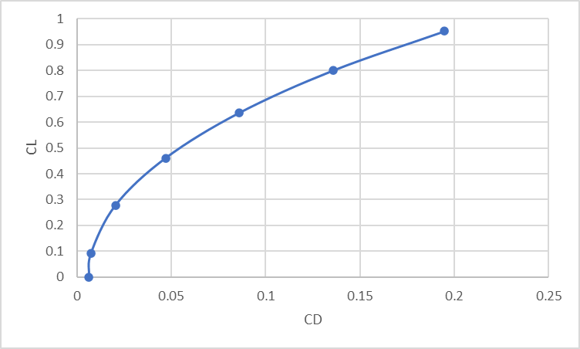
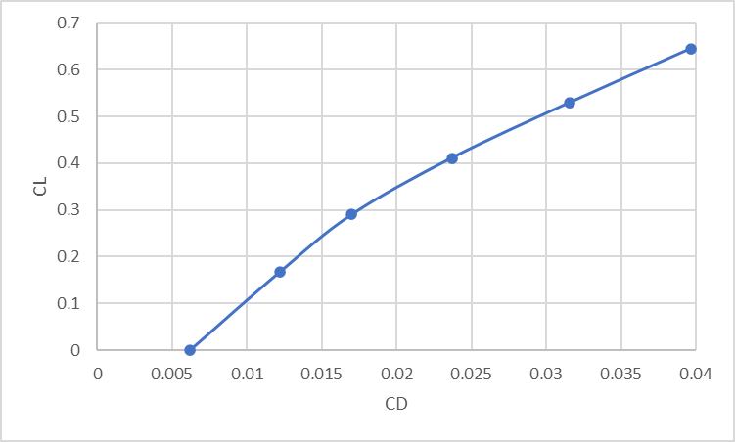
Drag Polar
Subsonic Drag Polar (Mach .95 cruise conditions)
Supersonic Drag Polar (Mach 2 cruise conditions)
CD,0 (M=0.95)​ | CD,0 (M=2)​ | CD,wave (M=2)​
.00594 | .00619 | .0032​

Slide 17
V-n Diagram
Selected +3G and -2G as limit loads
On par with transport category aircraft
Calculated V_{e} for cruise based on 50,000 ft density (448 fps)
Important speeds
V_{A}: 481 fps
Positive load stall: 277 fps
Negative load stall: 311 fps
Safety factor: 1.5
Example gust: 120 fps

Slide 18
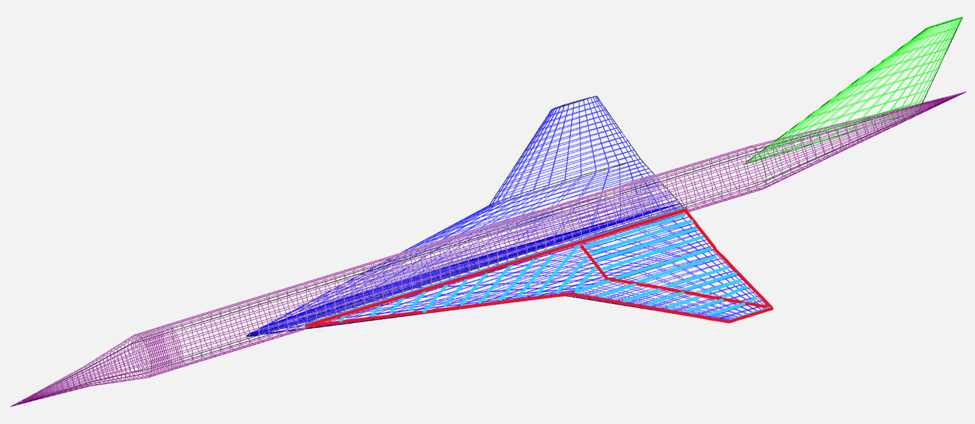
Structural Layout and Materials
Materials list:
Wings, empennage, fuselage: CFRP composites
Leading edges: titanium
Nose cone: E-glass reinforced epoxy composite
Structure
Wings/tail: spars and ribs
Fuselage: monocoque structure

Slide 19
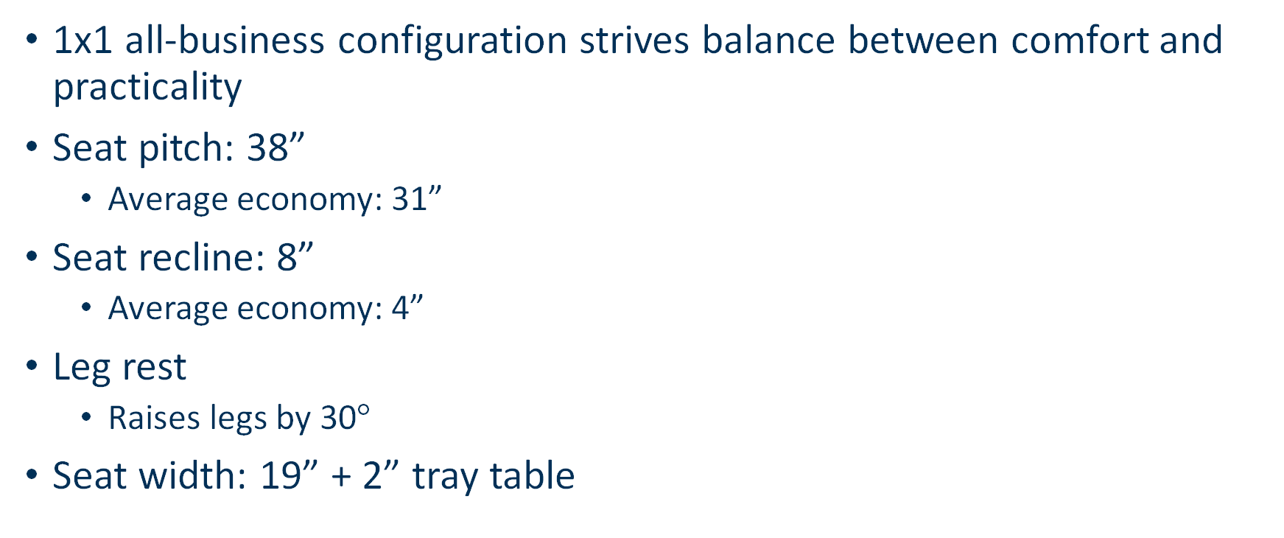
Cabin Configuration
1x1 all-business configuration strives balance between comfort and practicality
Seat pitch: 38”
Average economy: 31”
Seat recline: 8”
Average economy: 4”
Leg rest
Raises legs by 30$°$
Seat width: 19” + 2” tray table

Slide 20
Cabin Configuration, cont’d.
GALLEY
GALLEY
FD
25 rows 1x1 configuration, forward and aft galleys
Four emergency exits (Type C) as per 14 CFR 25.807
Two flight crew, two cabin crew

Slide 21
Cost Estimate
Primary goal: estimate cost for 200 production + 3 flight test aircraft
Used relationships from Nicolai & Carichner model
Hourly labor rates varied between $121 and $145 2022 USD
$124 mil unit cost when 200 aircraft produced
Highly competitive with the market; $30 mil cheaper than Concorde unit cost

Slide 22
Future Work
Express the CG excursion plot as a function of the % MGC from the LE of MGC
Determine vertical CG spread and landing gear tipover angles
Refine component moment arms
Close CG stability loop
Determine landing gear retraction scheme and precise location, adjusting the engine location as necessary to accommodate
Show pilot line of sight and determine a solution if vision is restricted during takeoff/landing (drooped nose vs camera, etc.)
Determine control surface sizing and placement
Determine stability derivatives
Select engine and inlet that satisfies propulsion requirements

Slide 23
Questions?

